Slide 1

BEST PRACTICE: HTML & CSS
Presented by:
Benson Wachira
wbenmurimi@gmail.com
12, 08, 2018

Slide 2
Open Class Summary (12th to 30th Nov (3 weeks))
Breakdown and integrate a mockups
HTML text elements
Page structure
Adding CSS
Build your first web pages with HTML and CSS
HTML text elements
Page structure
Adding CSS
Create web page layouts with CSS
Dimensional Layouts
Flex box

Slide 3


Slide 4


Free Templates & Mockups
Understand the basics first
Product design specification (PDS) web layouts
Bootstrap/ Materialize css templates
Color Palettes
Use GIT
Notes:
https://getbootstrap.com/
https://materializecss.com/
https://coolors.co/
https://fontawesome.com
https://www.w3schools.com

Slide 5
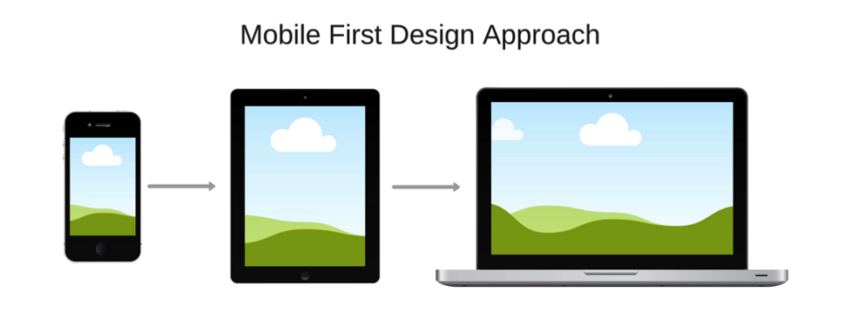
Mobile First Development
Optimize web pages for mobile devices
Using % instead of px in CSS
Media screen sizes

Slide 6
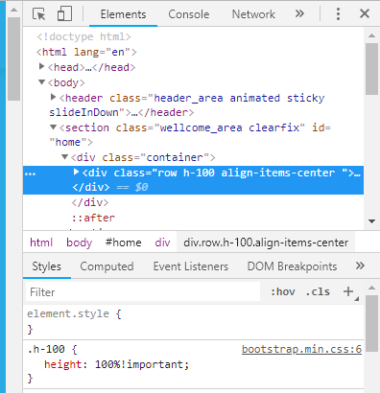
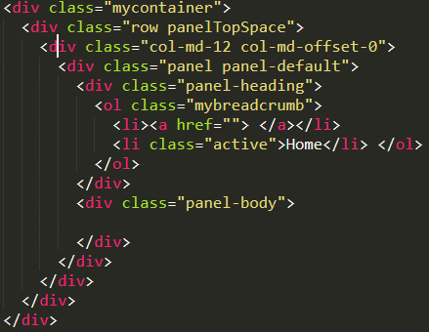
Debugging HTML & CSS
Inspect elements
Isolate pages
Proper code indentation
View templating engine

Slide 7

Developing for performance
Minimizing images
Minimizing CSS & HTML pages
Local file imports
Notes:
https://www.willpeavy.com/minifier/
https://cssminifier.com/

Slide 8

Optimizing for SEO
Using favicon
Headings, Meta Tags and Links for SEO
Robot.txt
Sitemap.xml
SSL certificate
Notes:
https://sitechecker.pro/
https://www.favicon-generator.org/
https://smallseotools.com/robots-txt-generator/
https://www.xml-sitemaps.com/

Slide 9
DEMO FILES
https://github.com/wbenmurimi/pro-html-css.git

Slide 10

Empowering Africa

